Slide 1
PARKINSON DETECTION USING VOICE DATA

Slide 2
INTRODUCTION
Parkinson's disease is a neurodegenerative disorder that affects movement, often resulting in symptoms such as tremors, stiffness, and difficulty with balance and coordination. Early detection of Parkinson's disease is crucial for timely intervention and management of symptoms. Voice data analysis has emerged as a promising approach for non-invasive and cost-effective early detection of Parkinson's disease. Voice data analysis offers a promising avenue for early detection and monitoring of Parkinson's disease, providing a non-invasive and accessible approach to assessing individuals' health status based on their speech characteristics.

Slide 3
The dataset contains the features like MDVP:Fo(Hz), MDVP:Fhi(Hz), MDVP:Jitter(%), MDVP:Shimmer, NHR, HNR, RPDE, DFA, PPE and so on to predict if the person has Parkinson’s are not.
The three algorithms are used to predict the accuracy of the prediction and to find the best one which gives the best accuracy. The three algorithms are Decision Tree Classifier, Random Forest Classifier and Logistic Regression. And create the user interface to give the voice recordings of healthy and affected people to predict if the person affected(1) or not(0).

Slide 4
SOFTWARE REQUIREMENT
PROGRAMMING LANGUAGE
Python: Widely used for data analysis, Python has a rich ecosystem of libraries and tools that are well-suited for tasks such as data cleaning, exploration, and visualization.
DATA ANALYSIS AND VISUALIZATION
Google Colab: Interactive notebooks facilitate exploratory data analysis and visualization and suitable for creating user interface.

Slide 5
Pandas: A powerful data manipulation library for cleaning and processing structured data.
Matplotlib and Seaborn: Libraries for creating static, interactive, and aesthetically pleasing visualizations.
STATISTICAL ANALYSIS
NumPy: Fundamental package for scientific computing with support for large, multi- dimensional arrays and matrices.
SciPy: A library for scientific and technical computing that builds on NumPy and provides additional functionality.

Slide 6
LIBRARIES
• Gradio: Python library that allows you to quickly create customizable UI components around your machine learning models.
• Sounddevice: Python library used for real-time audio input and output.
• Librosa: It provides functions for loading audio files, extracting various features from audio signals.
• Cloudpickle: It extends Python's built-in pickle module to support serialization of a wider range of Python objects, including functions, classes, and instances.

Slide 7
DATA EXPLORATION
DATA COLLECTION
The dataset of 195 records are used for the analysis. The data included MDVP:Fo(Hz), MDVP:Fhi(Hz), MDVP:Jitter(%), MDVP:Shimmer, NHR, HNR, RPDE,DFA", PPE and so on.
DATA PREPROCESSING
Before training the three selected model, ensure that preprocessed the data in a suitable format for analysis. We performed the following steps:

Slide 8
1. Data Cleaning: We removed records with missing or invalid data.
2. Data Transformation: We transformed categorical variables into numerical values.
3. Feature Scaling: We standardized the numerical features to have a mean of zero and a standard deviation of one.
4. Feature Selection: We used feature selection techniques such as correlation analysis to identify the most relevant features for predicting the disease.

Slide 9
MODEL TRAINING AND EVALUATION
The scikit-learn, a popular machine learning library in Python, to train a model on the preprocessed data. It splits the data into training and testing sets, with 70% of the data used for training and 30% for testing. We used Precision, Recall and F1 Score as the evaluation metric to measure the accuracy of the model.
PREDICTION
Once the model was trained and evaluated, It compares the three model and identify the model which gives the best accuracy of results.

Slide 10
EXPLORATORY DATA ANALYSIS
Exploratory Data Analysis (EDA) is the process of examining and analyzing datasets to review their main characteristics, usually with visual methods. It is used to discover patterns, relationships, anomalies and other insights that might be hidden in the data. EDA is an important step in the data analysis process because it helps to better understanding of the data, identify potential problems or errors and generate hypotheses.

Slide 11
In EDA, the initial step involves a comprehensive understanding of the problem at hand and the establishment of clear goals. Data collection is then performed by gathering relevant information considering features such as MDVP:Fo(Hz), MDVP:Fhi(Hz), MDVP:Jitter(%), MDVP:Shimmer, NHR, HNR, RPDE, DFA, PPE. Subsequent data cleaning ensures the quality of the dataset by addressing missing values, duplicates, and outliers. visualizations using tools like matplotlib or seaborn. Feature engineering is applied to create new variables that may enhance prediction accuracy, and correlation analysis helps identify relationships between features and the target variable (Status).

Slide 12
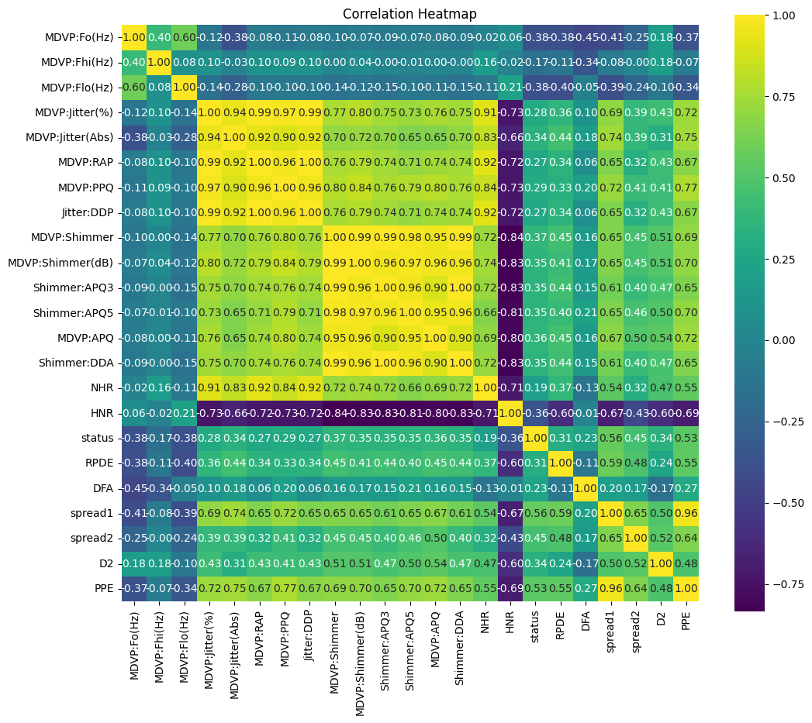
DATA VISUALIZATIONS
Correlation of all data in the dataset

Slide 13
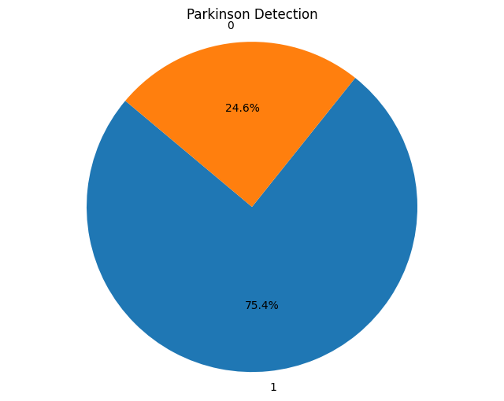
Pie chart for counting value (0 – Healthy people, 1 – Affected people)

Slide 14
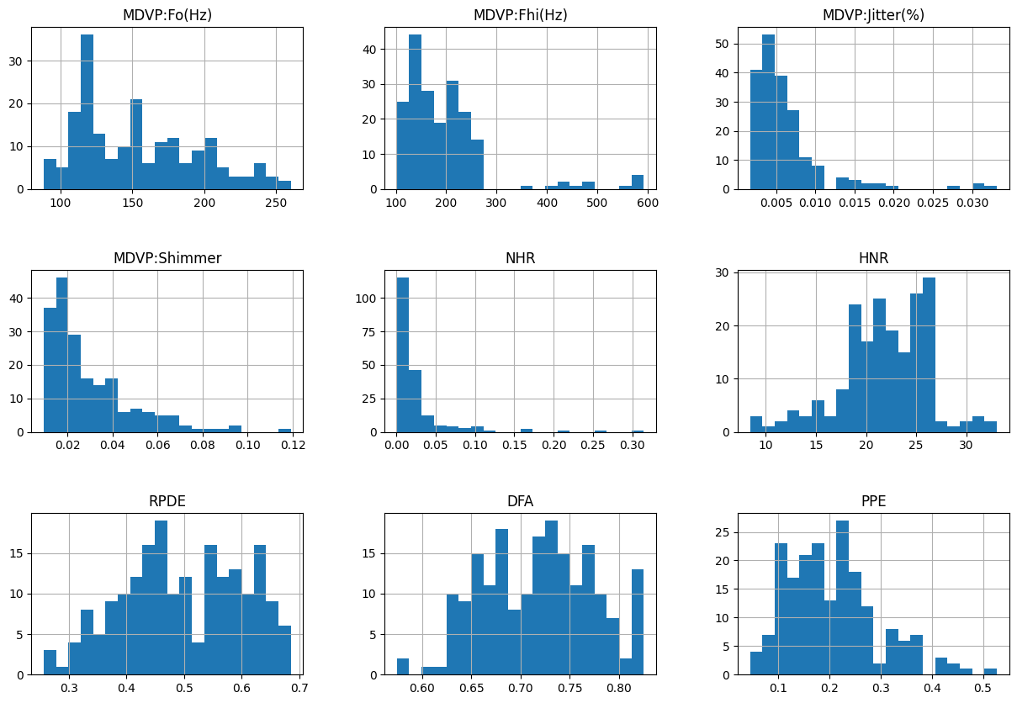
Histogram for important feature in dataset

Slide 15
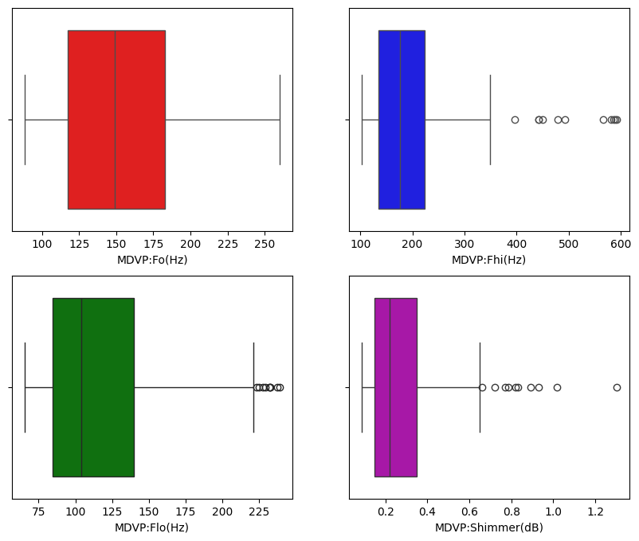
Boxplot for detecting outliers

Slide 16
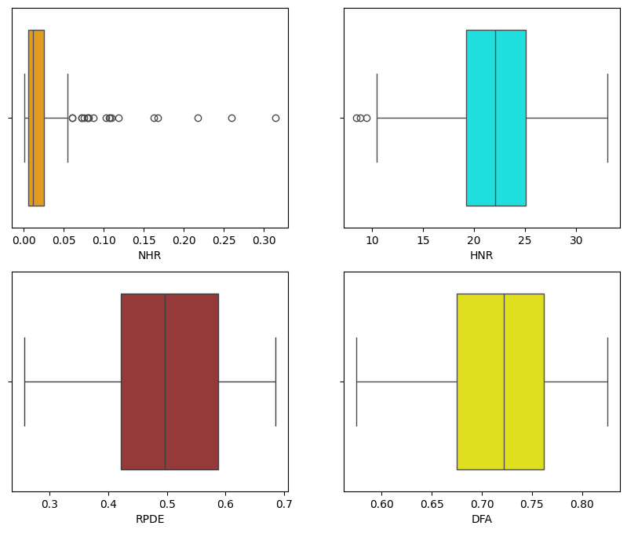

Slide 17
MACHINE LEARNING MODELS
RANDOM FOREST CLASSIFIER
By analyzing these dataset, the Random Forest Classifier can effectively identify patterns associated with Parkinson's and provide valuable insights for diagnosis. This model demonstrates promising results, achieving 93.22% accuracy on a held-out test set. With its ability to handle complex data and provide interpretable results, the Random Forest Classifier serves as a valuable tool in the early detection and management of Parkinson's disease.

Slide 18
DECISION TREE CLASSIFIER
This classifier works by recursively partitioning the feature space, creating decision nodes based on feature thresholds to separate the data into homogenous subsets. These decision rules provide insight into the factors contributing to Parkinson's disease progression, aiding in diagnosis and treatment planning. This model achieved 92.31% accuracy on a held-out test set, demonstrating its potential as a valuable tool in the early detection and management of Parkinson's disease.

Slide 19
LOGISTIC REGRESSION
The Logistic Regression algorithm demonstrated promising results, achieving 89.74% accuracy on a held-out test set. Its simplicity and effectiveness make a valuable tool in the early detection and monitoring of Parkinson's disease, offering insights that can inform clinical decision-making and improve patient outcomes.

Slide 20
MODEL PREDICTION ACCURACY
BEST ACCURACY – K- NEAREST NEIGHBOR
MODEL | ACCURACY | STATUS | PRECISION | RECALL | F1 SCORE | SUPPORT
Random Forest Classifier | 93.22% | 0 | 0.92 | 0.80 | 0.86 | 15
 |  | 1 | 0.93 | 0.98 | 0.96 | 44
Decision Tree Classifier | 92.31% | 0 | 0.83 | 0.71 | 0.77 | 7
 |  | 1 | 0.94 | 0.97 | 0.95 | 32
K- Nearest Neighbor | 94.87% | 0 | 1.00 | 0.71 | 0.83 | 7
 |  | 1 | 0.94 | 1.00 | 0.97 | 32

Slide 21
USER INTERFACE
The Gradio interface offers a simple yet effective tool for predicting Parkinson's disease using audio data analysis. Leveraging machine learning techniques and the Random Forest model which is saved as pickle file, the system takes an audio file as input, extracts relevant features using the librosa library, and makes predictions based on the learned patterns.
Once the file is uploaded, the system processes it, extracts Mel-frequency cepstral coefficients (MFCCs), computes their mean, and feeds them into the trained Random Forest model. The predicted result, indicating the likelihood of Parkinson's disease presence, is displayed as 0 for healthy people and 1 for affected people.

Slide 22
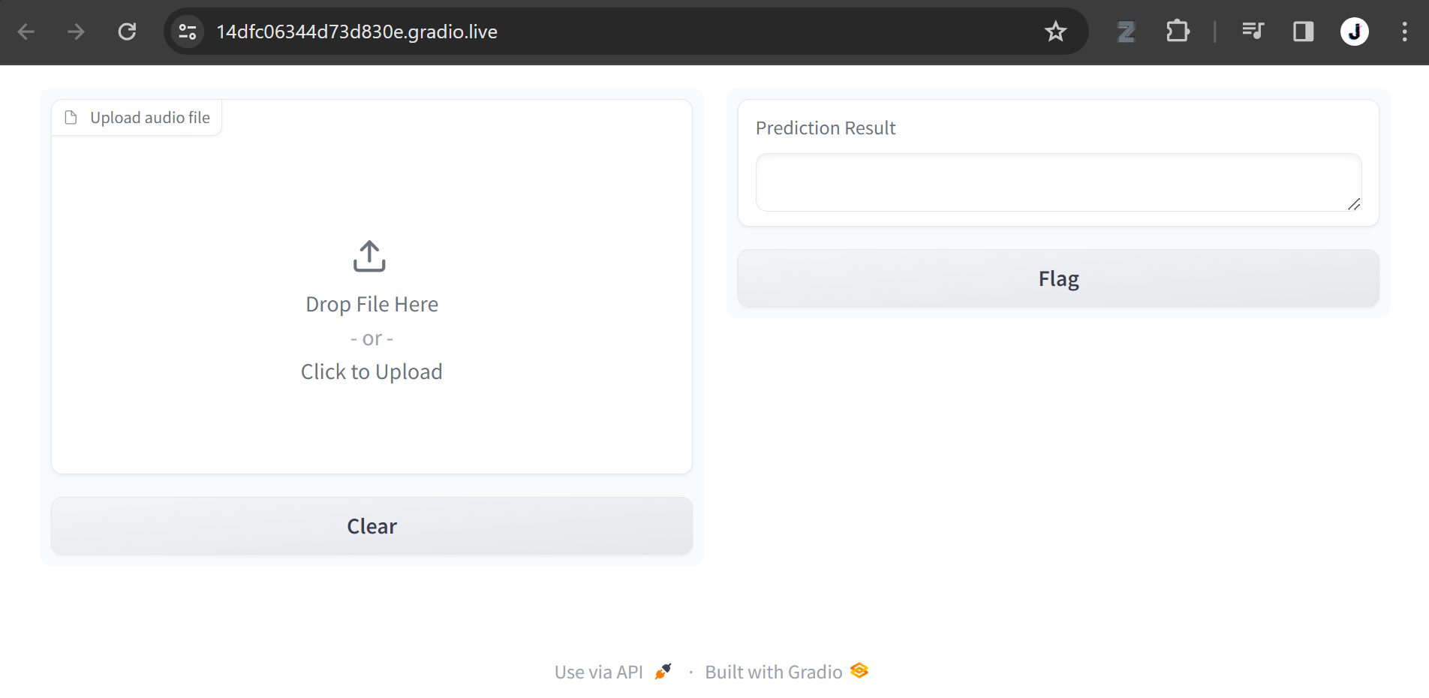
SCREENSHOT

Slide 23
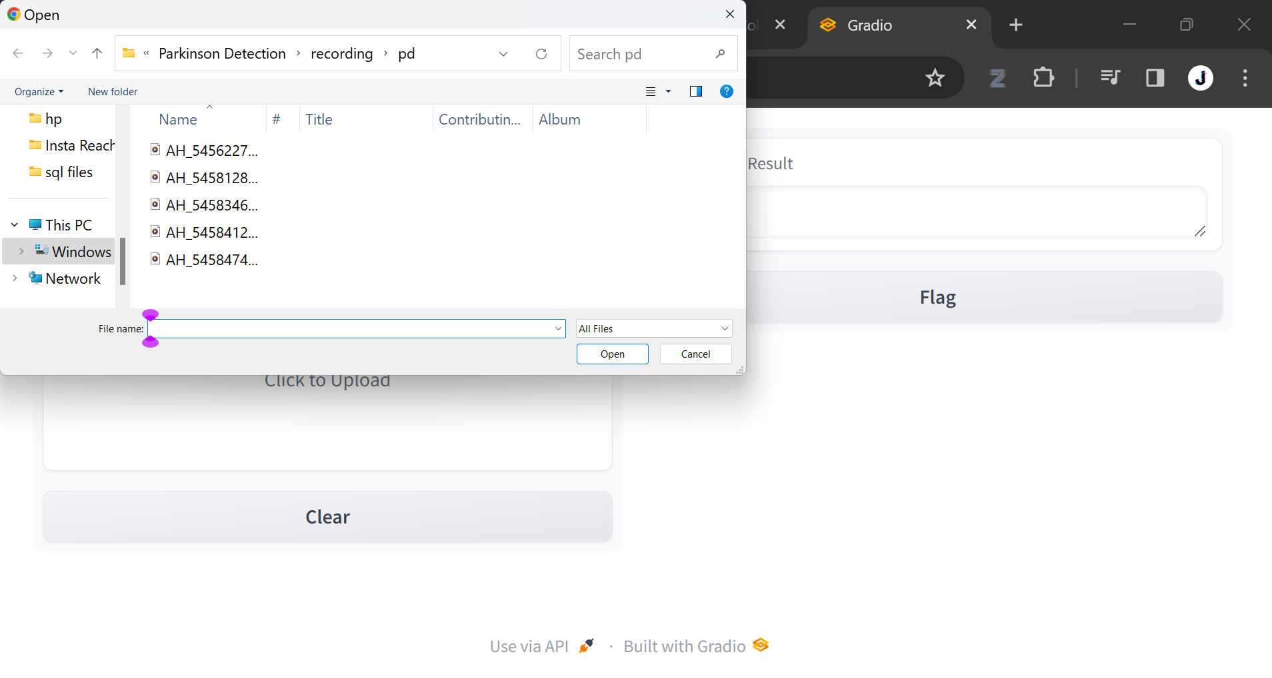

Slide 24
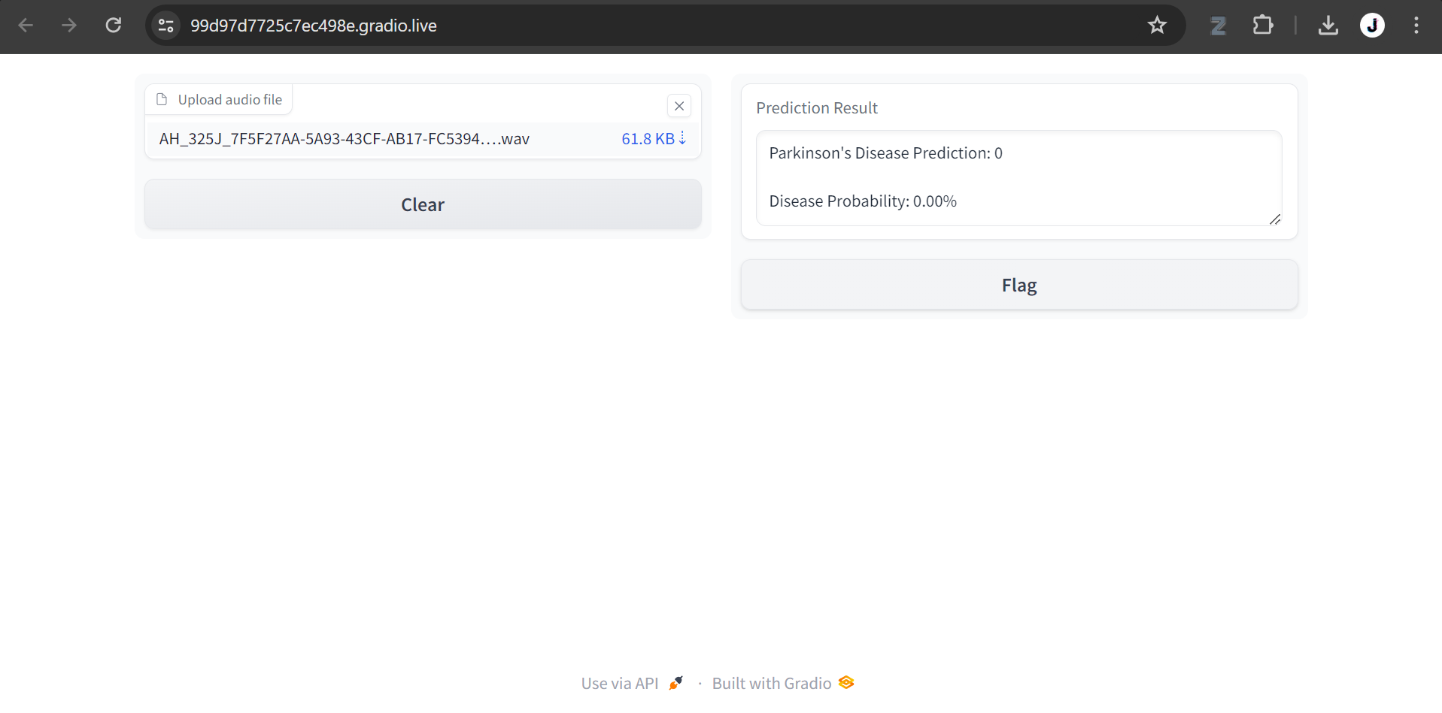

Slide 25
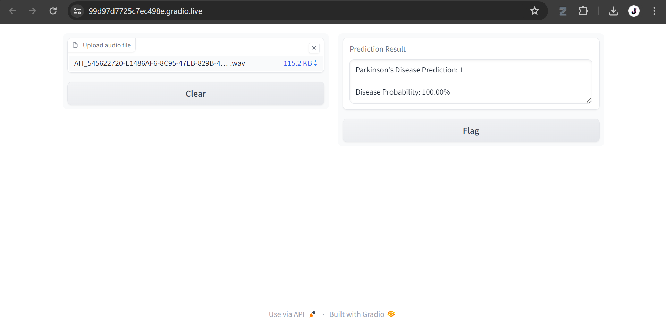

Slide 26
FUTURE SCOPE
In the future, the scope for Parkinson's disease detection using voice data is poised for significant advancements. By integrating cutting-edge techniques such as Natural Language Processing (NLP) and voice analysis, researchers can delve deeper into the subtleties of speech patterns and vocal characteristics associated with Parkinson's disease progression. Advanced NLP algorithms could be harnessed to analyze nuances in speech, including changes in vocal pitch, tone, and articulation, offering insights into the onset and progression of the disease.

Slide 27
CONCLUSION
In conclusion, the application of machine learning techniques for Parkinson's disease detection using voice data holds tremendous promise for early diagnosis and personalized treatment. By harnessing advanced algorithms and signal processing methods, researchers can extract valuable insights from speech patterns and vocal characteristics associated with Parkinson's progression. Through ongoing research and innovation, the intersection of machine learning and voice analysis offers a transformative approach to Parkinson's detection, ultimately improving patient outcomes and enhancing the quality of life for individuals living with the disease.

Slide 28
THANK YOU

